Slide 1
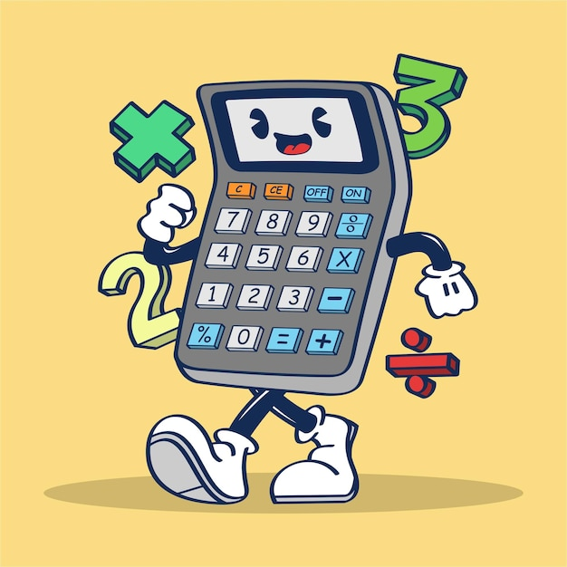
Project A Quizzing
Uber
Awesome
Calculator

Slide 2
Agile Project A
Create a calculator to be used by primary school pupils. The calculator should allow students to perform basic mathematical calculations (addition, subtraction, multiplication and division.) It should also serve as a math quiz app to test pupils on their math calculations and give them as score. The calculator should have a print, import and export functionality.

Slide 3

Teams Roles and Responsibilities
Role | Name | Responsibilities
Software Developer/ UX Designer | Dipanju | Code insights and approaches for user stories, weighing in on scrum technical decisions and team imput.
Architect | Conner | Lead on the technical structure and approaches for tackling user stories. Support the software developers to work out the best paths delivery the program.
Project Manager/ Scrum Master | Shere | Facilitate Agile ceremonies, lead scrums, manage project, ensure timeline adherence.
UX Designer/ Scrum Master | Sebastian | Design prototypes and approaches for the front-end side of the program, liaise with technical team to make these deliverable, weigh in on the team scrums.
Tester | Sony/Abi | Suggest testing approaches to ensure functionality and quality assurance of the programs and design, weigh in on team scrums.

Slide 4

Day 1 | Scrum 1 Analysis

Slide 5
USER STORIES BACKLOG
CODE | AS A… | I NEED… | SO THAT…
101 | End User | Enter my name and age, and be able to choose between using the calculator and take an age-appropriate quiz | I can enter my name and my age when prompted. I can choose whether to use the calculator or take a quiz.
102 | End User | Use the calculator for a range of operations and be able to save & review my results | I can carry out operations and save my results of calculations and return to them to see what they were. The user should be able to save the solution and be able to go back and see what it was.
103 | End User | Take a quiz according to different age groups and be able to cheat on the quiz | I can take the age-appropriate test based on the information I’ve recorded before. There will be three sets of tests: Year 1-2 (6 to 7) Addition, deletion and multiplication. Year 3-4 (8 to 9) Exponential, average calculation and division. Year 5-6 (9 to 11) Percentages, decimals, square. Bonus advanced quiz: Algebra, fractions. The test will let me know if I passed or failed, it would calculate my mark. The tests will be randomly generated from a range of parameters. I can cheat on the tests by: Pop up a calculator on the side ready for cheating. Entering an age different than mine to take a different quiz (when prompted at the start)
Notes:
Each individual role will have six slides (scrum cards for each day?)
First slide: Architect
We have to have a slide on what we will do on every daily scrum
Maybe cheating about age group in the quiz.
Playing games in calculator instead of doing calculation?? Cheating??
Like making smileys etc.
https://tinypic.host/image/Calculator-User-Stories.Dj9vbO

Slide 6
Daily Scrum Ceremony
DETAILS |  | DESCRIPTION
Sprint | A | Gather the team to discuss the user stories and how we might approach the requirements they have according to the users of the program (primary school children). Sorted the roles of everyone in the team. Prepared and delivered the recipe program requirements for the other team. Wrote the three user stories and expanded out beyond basic requirements, already discussing and recording possible approaches. We agreed on a simple, user friendly and functional approach to the user stories.
Phase | Analysis
Role | Project Manager / Scrum Master
Day | 1/2
User Stories | All

Slide 7
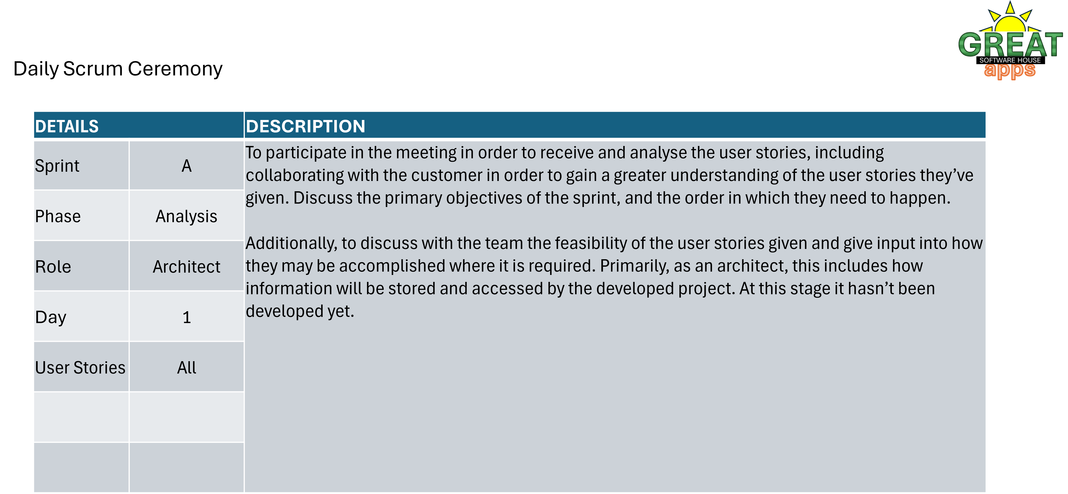

Slide 8
Daily Scrum Ceremony
DETAILS |  | DESCRIPTION
Sprint | A | To review user stories and understand the requirement for each of them
Phase | Analysis
Role | UX Designer
Day | 1/2
User Stories | All

Slide 9
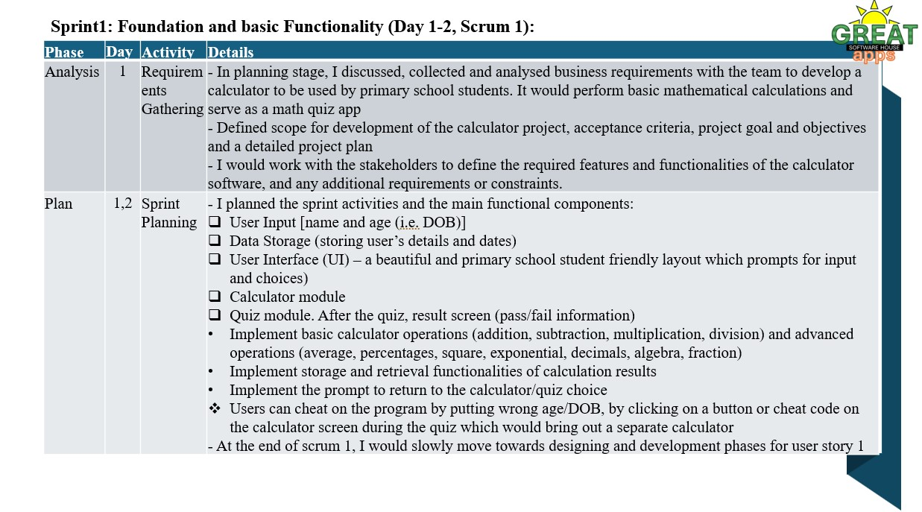

Slide 10
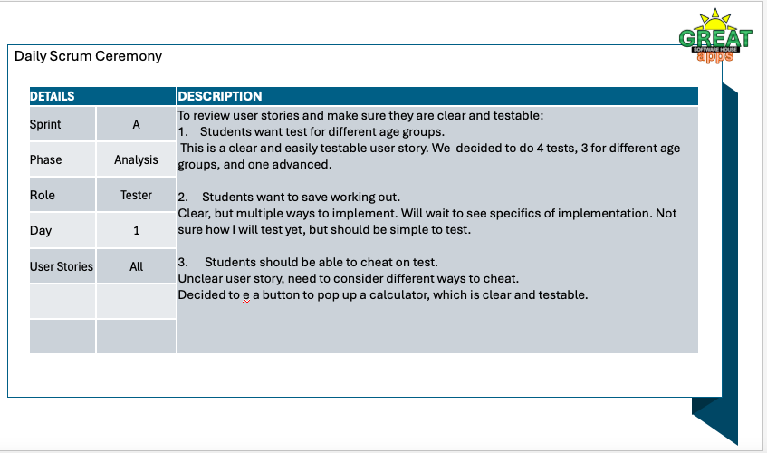
make

Slide 11
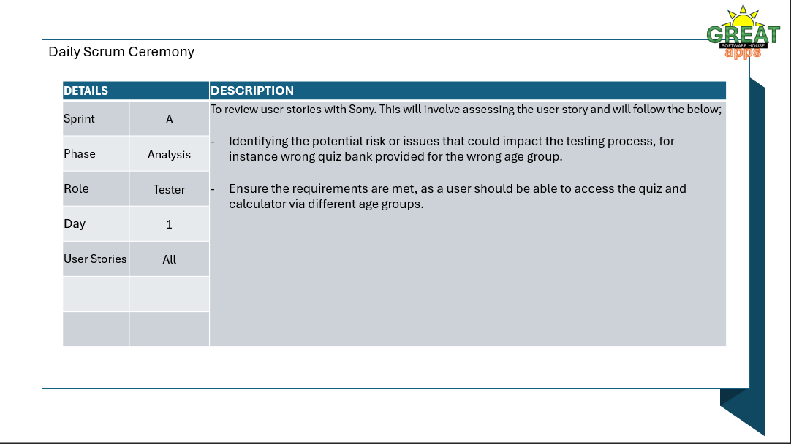

Slide 12
Day 2 | Scrum 2 Planning User Story 1

Slide 13
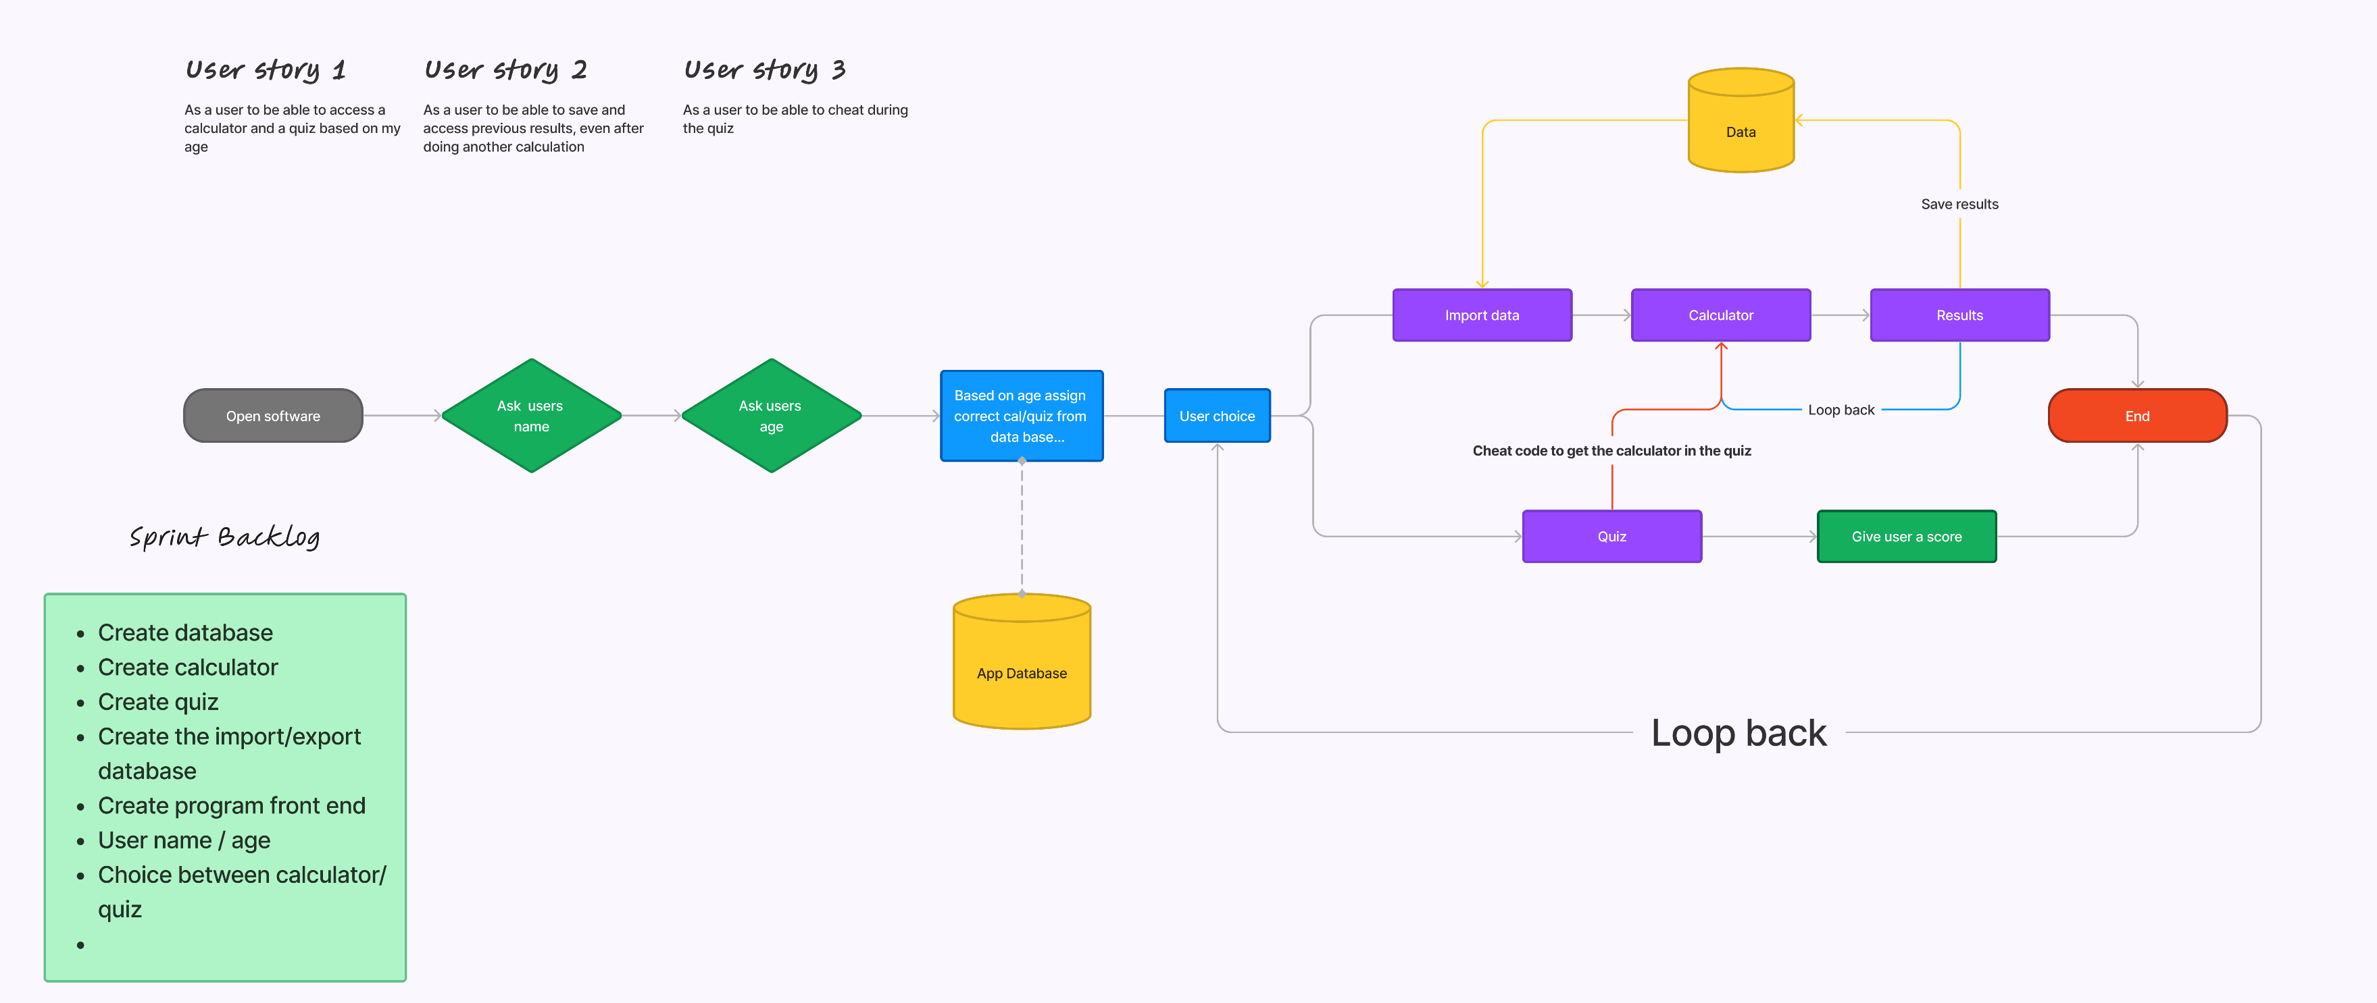
Daily Scrum Ceremony

Slide 14
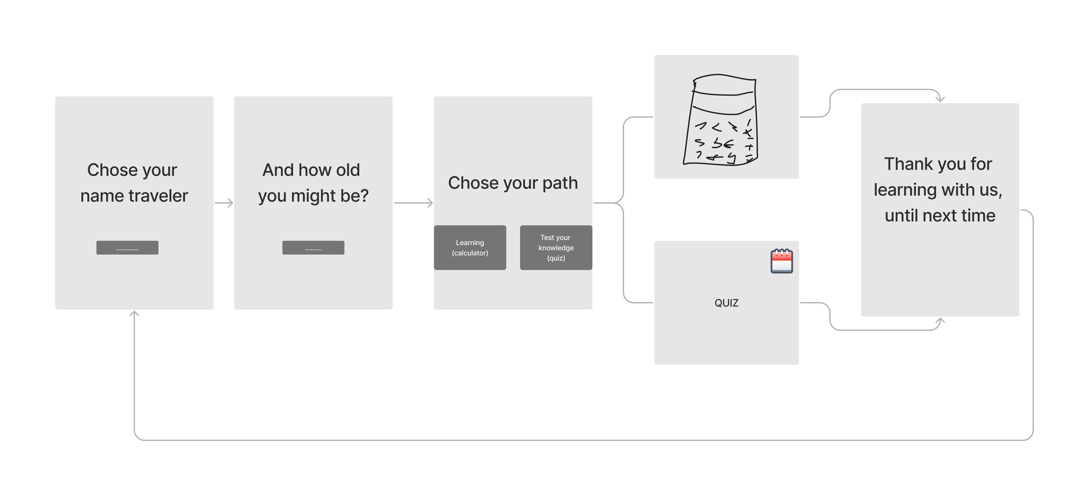

Slide 15
Daily Scrum Ceremony
DETAILS |  | DESCRIPTION
Sprint | A | Following our analysis meeting, we gathered in the scrum to scope out the user stories, design on the approaches for the functionality and usability of them and onboard two new members of the team who joined it (Abi as Tested with Sony, Mahi as Software Developer with Dipanju). Sebastian produced a flow chart to help us work out the user stories. We discussed the user stories using the flow chart as prompt, with the finished user stories left with the team to progress. First focus is user story 1. User story 1: The end user opens the calculator program and enters their name and age when prompted. The date is stored (app database) in order to be able to suggest age-appropriate quizzes later. Once the user has entered these inputs, they are prompted to choose between using the calculator and taking a quiz. User story 2: The end users chooses the calculator function and is able to carry out a range of operations (summation, subtraction, multiplication, division, calculation of percentages, square, exponential, decimals, algebra, fractions). The results of their calculation are stored. The user is able to recall these results to review them. When the user is done with the calculator, they can return to the point of choice between calculator/quiz via a prompt to return (Yes/No answer). User story 3: The end user chooses to take a quiz. An age-appropriate quiz is pulled forward for a range of age-appropriate quizzes stored in the program. The end users takes the quiz, the program calculates whether they passed or failed. The program assigns a numerical mark to their results based on the 100% pass. The end user is able to cheat on the quiz by inputting a cheat code that will pop the calculator up for them to use during the quiz. When the user is done with the calculator, they can return to the point of choice between calculator/quiz via a prompt to return (Yes/No answer).
Phase | Sprint Planning
Role | Project Manager/Scrum master
Day | 2
User Stories | 1

Slide 16
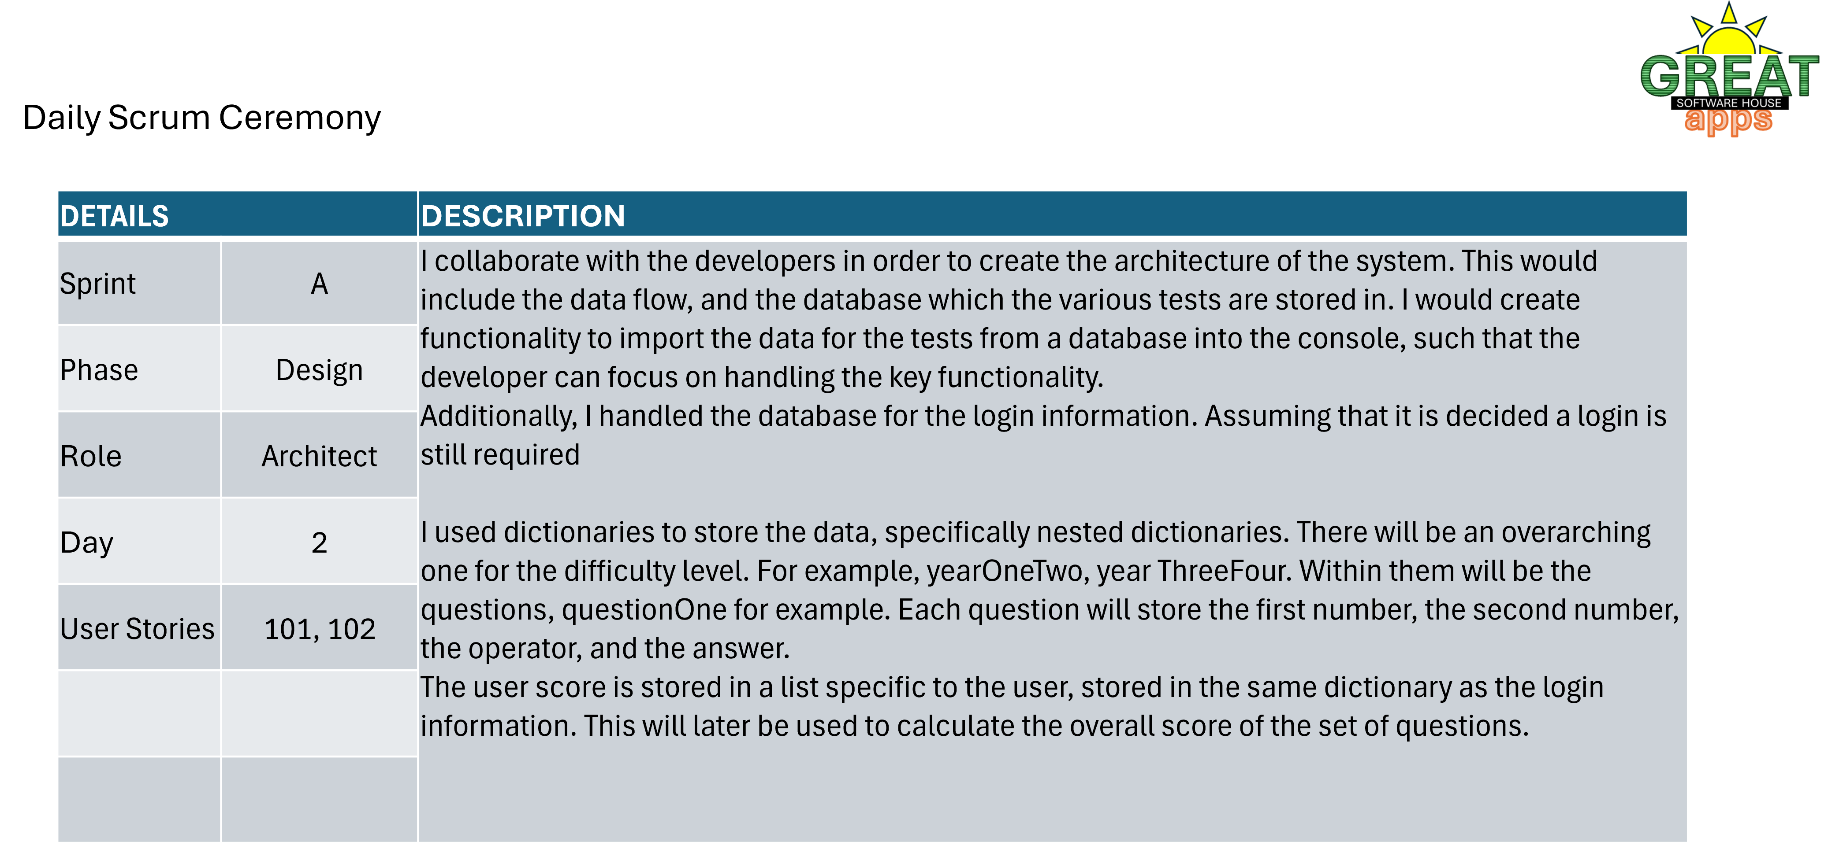

Slide 17
Daily Scrum Ceremony
DETAILS |  | DESCRIPTION
Sprint | A | Collaborate with the scrum master/project manager and the developers to understand the user needs and help to prioritize features. Starting to create prototypes of the design and wireframes. User story1: First page should have the prompt for the user to input his name and a box below where they can input, which will go in to the second page with a prompt asking their age and a box below where they have a drop-down menu to chose between ages 6 to 11. Getting them to the next page where they are prompted to make a choice, two different clickable and labeled buttons on the screen, one goes to the calculator and one to the quiz.
Phase | Plan
Role | UX Designer
Day | 2/3
User Stories | All

Slide 18
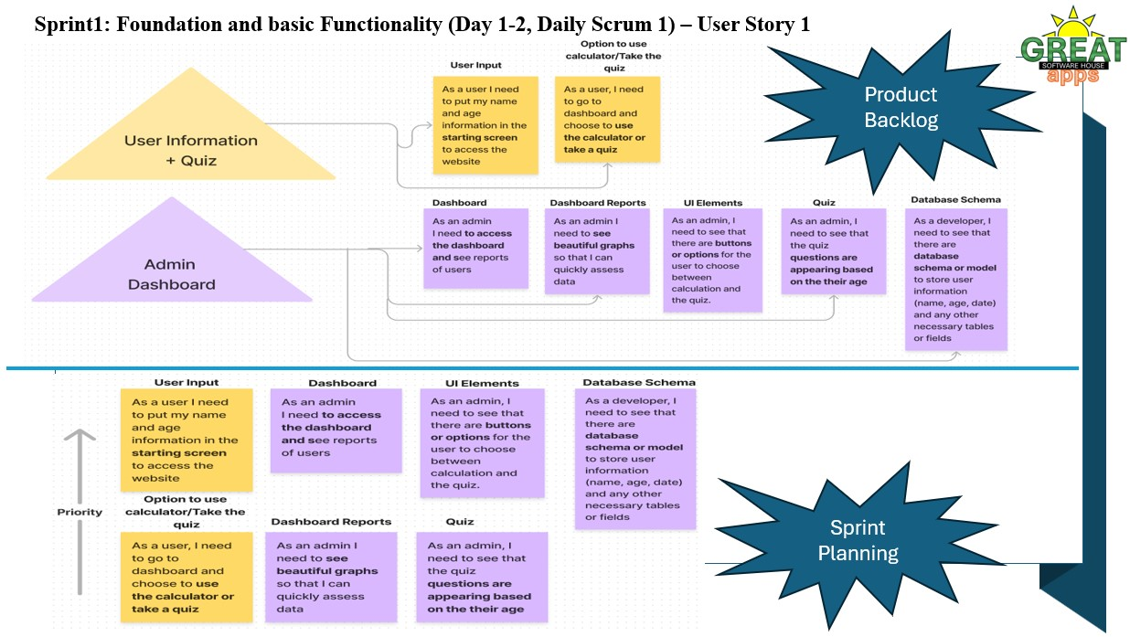

Slide 19
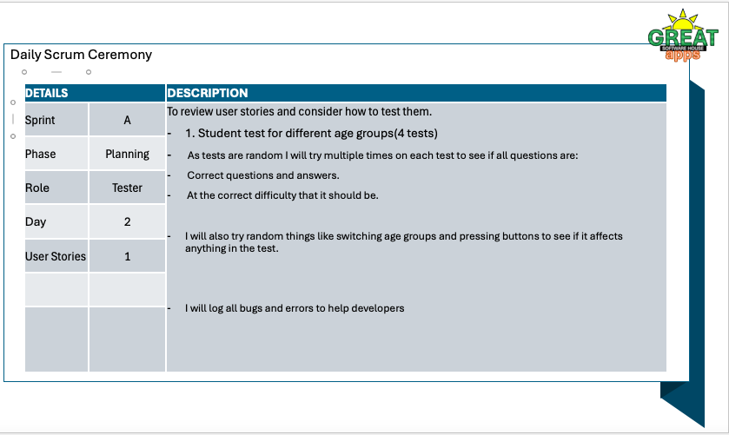

Slide 20
Day 3 | Scrum 3 Design User Story 2

Slide 21
Daily Scrum Ceremony
DETAILS |  | DESCRIPTION
Sprint | A | We reviewed the prototypes that Sebastian had created on the first user story. Sebastian presented a fun concept where users are time travelers, and this program is a point of encounter to learn (calculator) and to test your knowledge) quiz. I raised a point on the language on the age prompt (‘and how many winters might you have?’). This was lovely and it made us all laugh, but I was concerned that the younger group might not understand that this meant age. This program is for primary school children. Dipanju also had this concerned and suggested that this would be best kept simple. Sebastian changed it. We refocused on User story two and everyone agreed to go ahead and do that. I’ve been putting together the slides. The focus now is User Story 2.
Phase | Design
Role | Project Manager/Scrum master
Day | 3
User Stories | 2

Slide 22
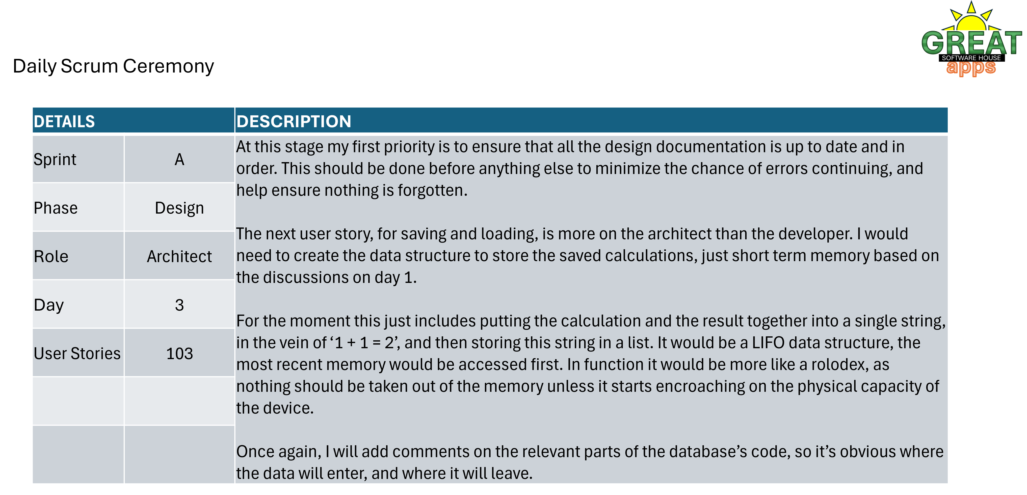

Slide 23
Daily Scrum Ceremony
DETAILS |  | DESCRIPTION
Sprint | A | User story2: The calculator page will have the looks of a calculator, and 3 different boxes where the user can input 2 numbers and calculation of their choice. Another box underneath the 3 will show the result. On the lower page will be 2 buttons where the user can choose if they want to save their result or see a previous results. User story 3:User will be given a mathematical calculation and will have a box where they can enter their result for the calculation, in the upper right corner there will be an icon of a calculator that if it`s clicked by the user will bring up the calculator. Upon exit from the calculator/ quiz the user will be prompted with the message “ Thank you for learning with us, until next time” and loop back to the first page.
Phase | Design
Role | UX Designer
Day | 2/3
User Stories | All

Slide 24
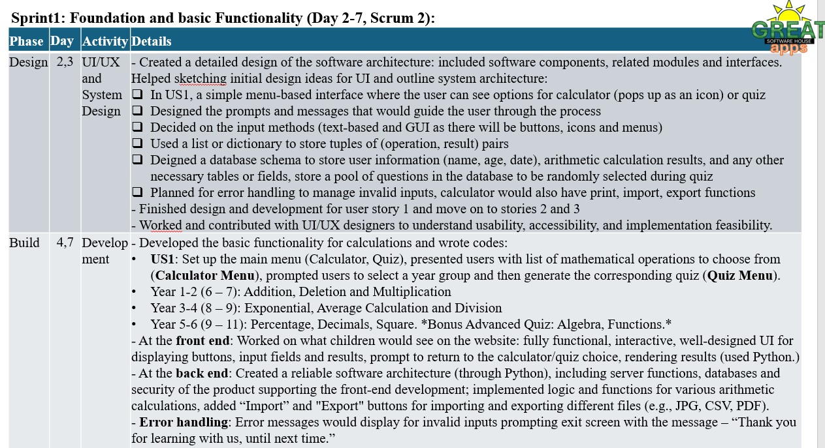

Slide 25
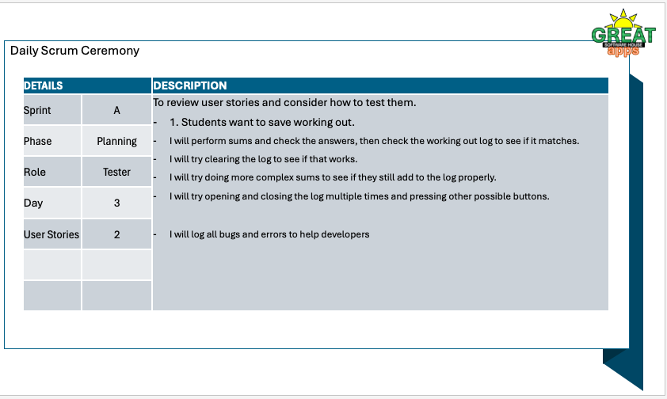

Slide 26
Day 4 | Scrum 4 Build User Story 3

Slide 27
Daily Scrum Ceremony
DETAILS |  | DESCRIPTION
Sprint | A | We reconvened to focus on user story 3. We reviewed the functionality and Sebastian shared his UX approach for User Story 2 and 3. On User Story 2 we discussed how will the user be able to see the results once they have used their calculators. Sebastian suggested buttons with Import/Export buttons. I raised the issue of the language of the buttons. Dipanju discussed whether we would do a log-in for this to be saved and pulled when prompted. Sebastian suggested the session records but it stops after, which is what we had been discussing. After this we agreed to keep it simple. For user story 3, we agreed to keep the cheating simple by being able to click on the calculator button Sebastian suggested and thus being able to cheat by using the calculator whilst taking the test. We spoke about the loops to return to the User Choice step and/or to return to the beginning.
Phase | Design
Role | Project Manager/Scrum master
Day | 4
User Stories | 3

Slide 28
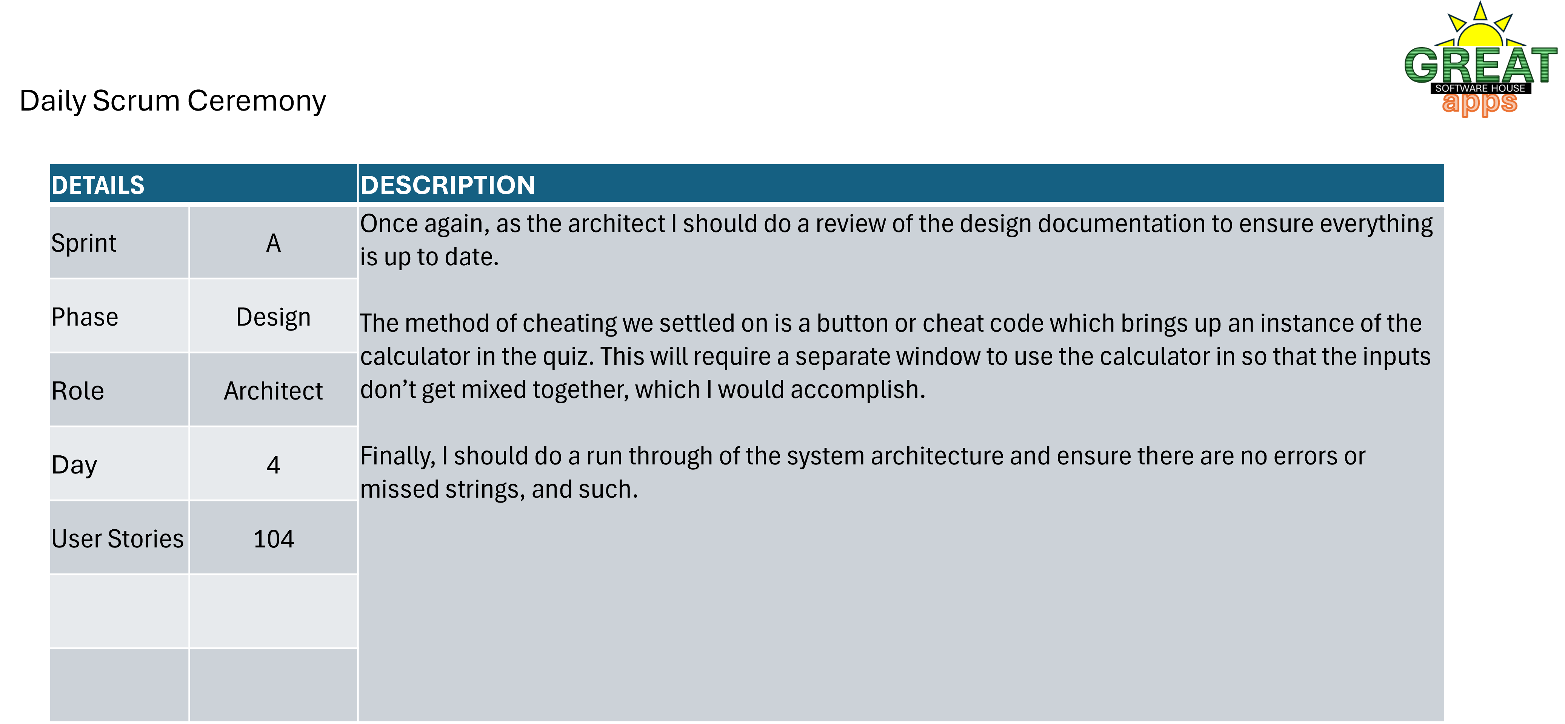

Slide 29
Daily Scrum Ceremony
DETAILS |  | DESCRIPTION
Sprint | A | Make sure the developers are following the design plans.
Phase | Build
Role | UX Designer
Day | 4
User Stories | All

Slide 30
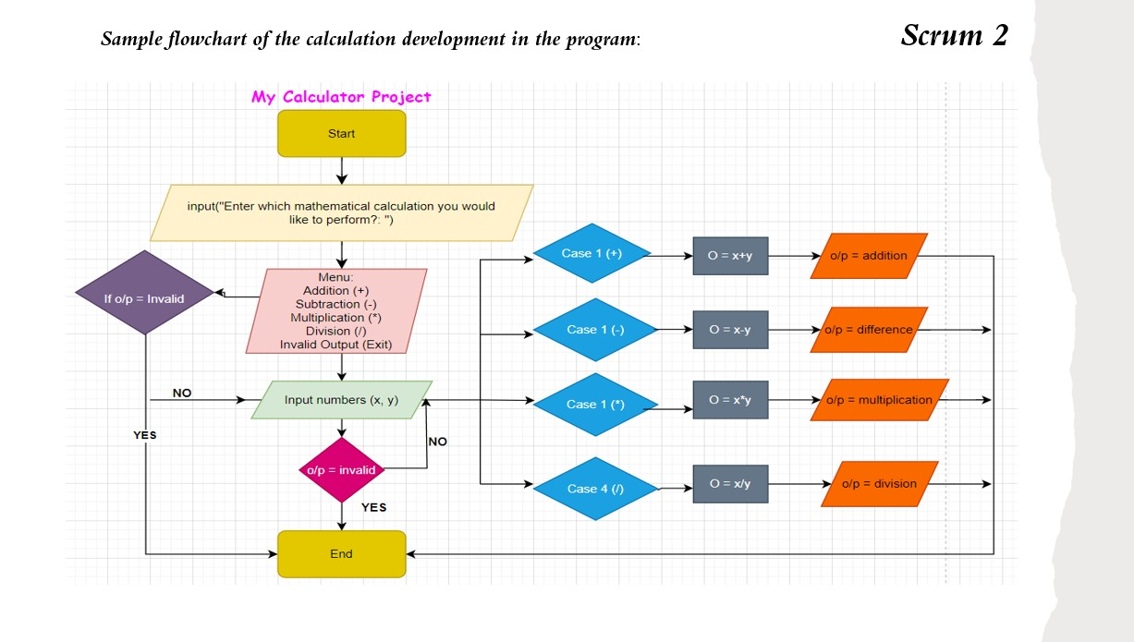

Slide 31
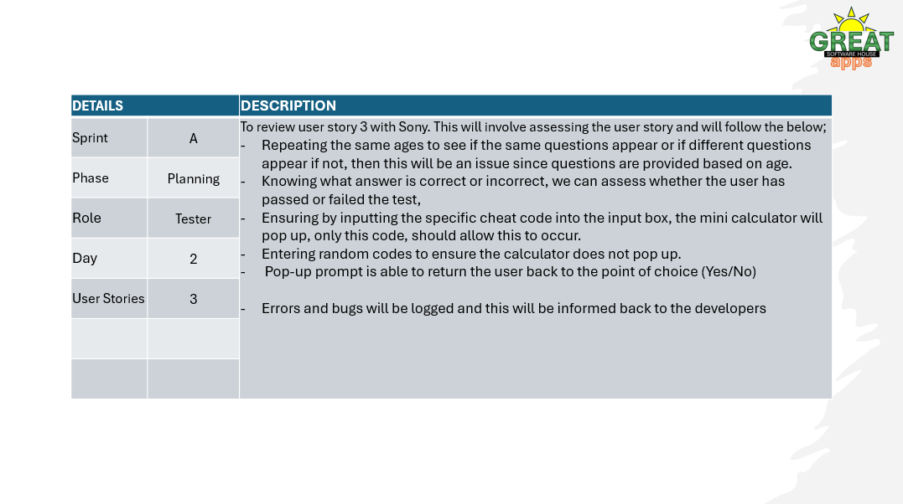

Slide 32
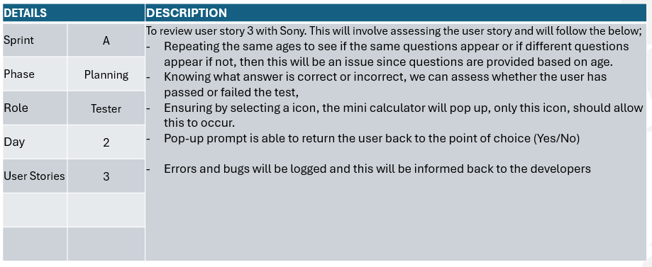

Slide 33
Day 5 | Scrum 5 Test

Slide 34
Daily Scrum Ceremony
DETAILS |  | DESCRIPTION
Sprint | A | With the three user stories scoped out, designed, approaches agreed and code presented, we came together to review the app once again and make sure we’re ready to initiate the testing. - Testers are collaborating and divvying up the testing. Software developer is working with the testers and architect to iterate following the tests. UX Designer is supporting the delivery of the design alongside the program I’m around to keep the project going how I can and support the team to deliver on our deadlines. Soon we will seek client input before launch.
Phase | Design
Role | Project Manager/Scrum master
Day | 5
User Stories | All

Slide 35
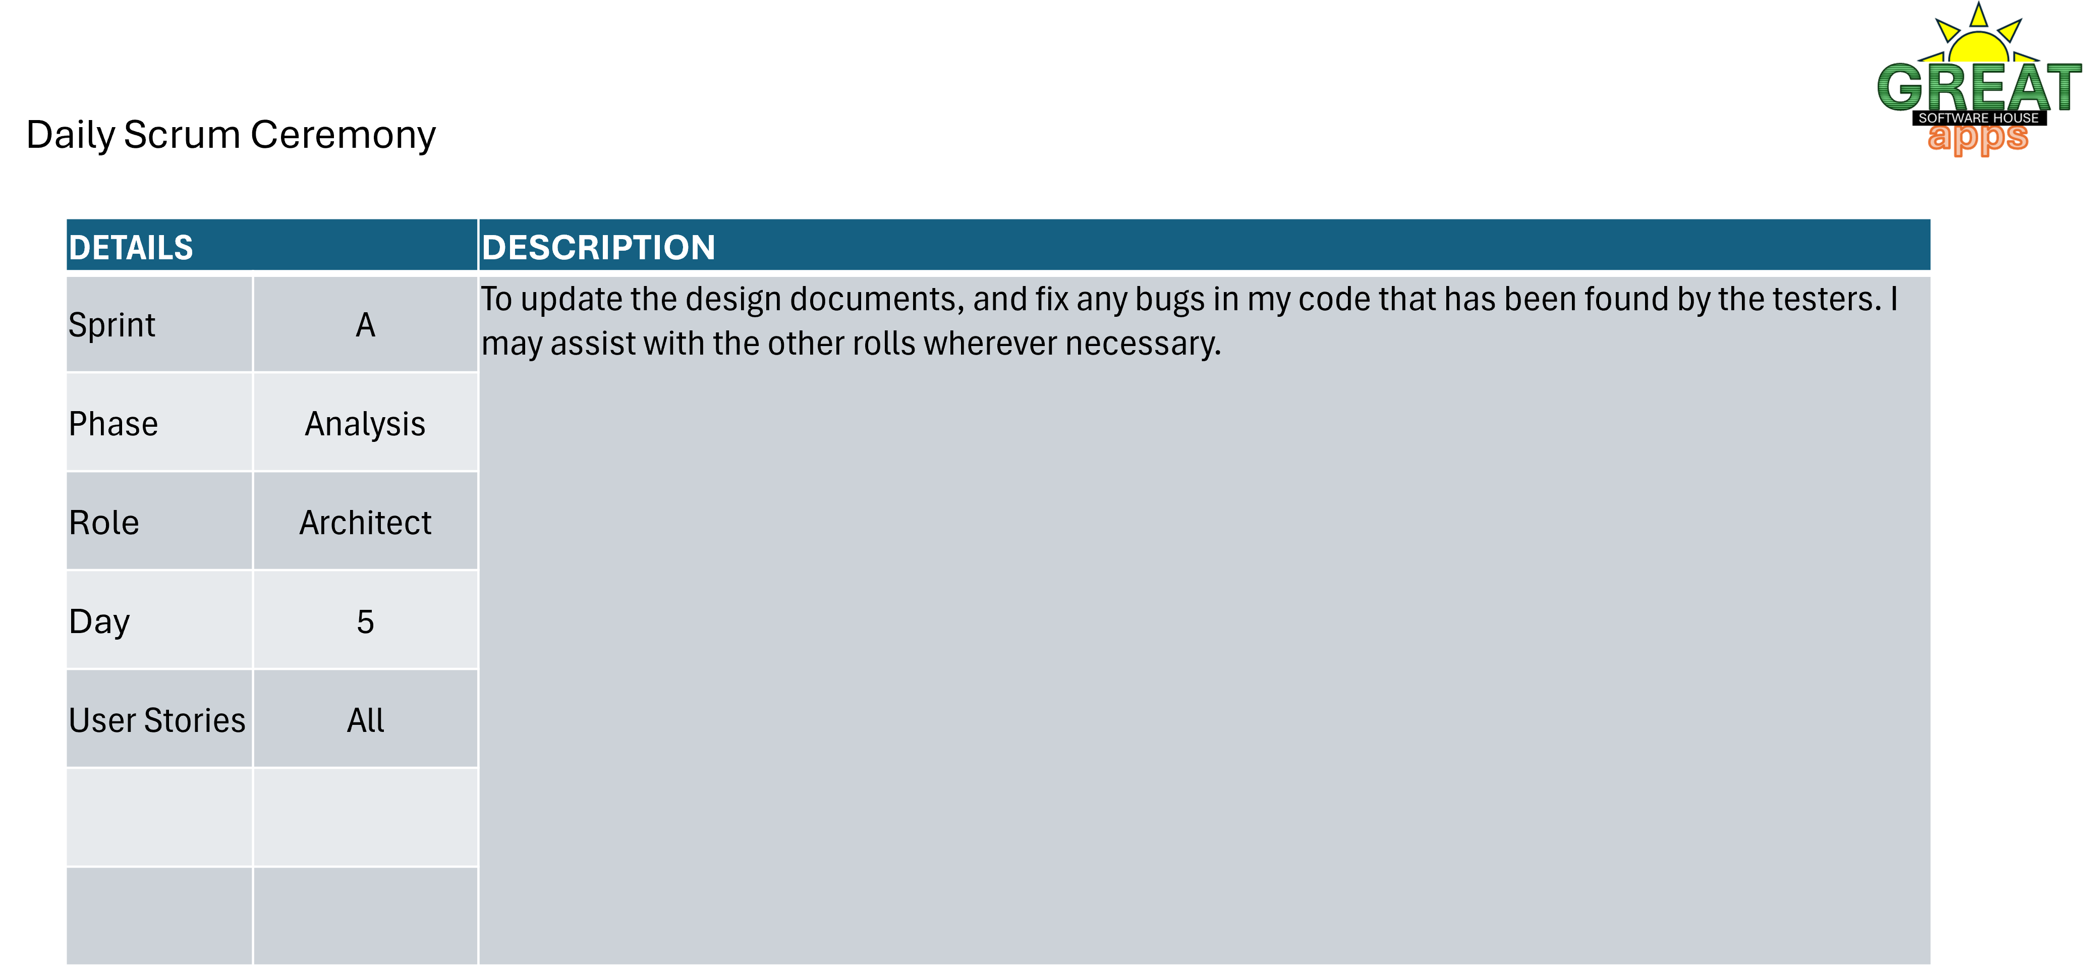

Slide 36
Daily Scrum Ceremony
DETAILS |  | DESCRIPTION
Sprint | A | Make sure everything is in the right place and functional.
Phase | Test
Role | UX Designer
Day | 5
User Stories | All

Slide 37
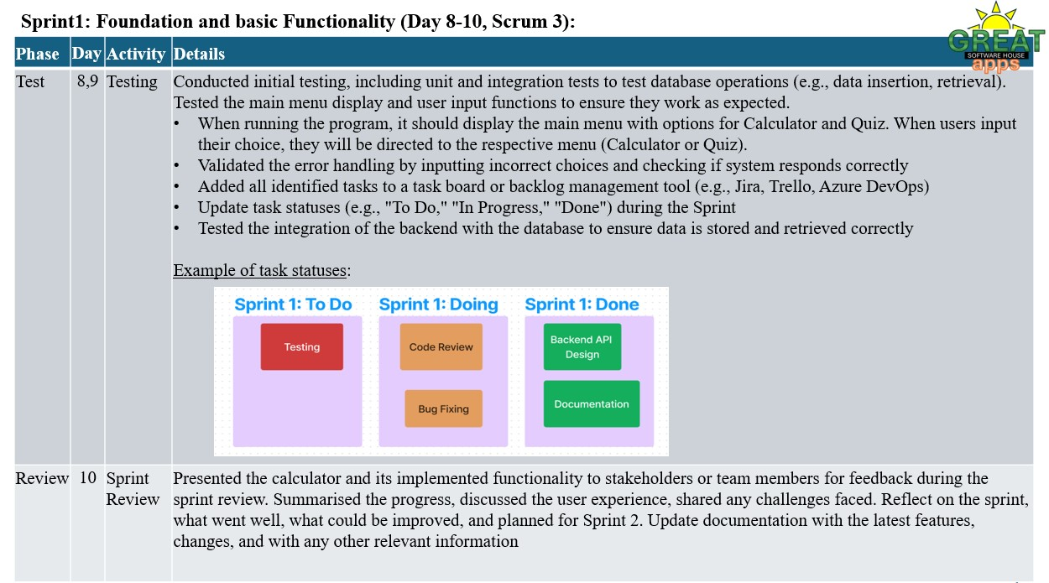

Slide 38
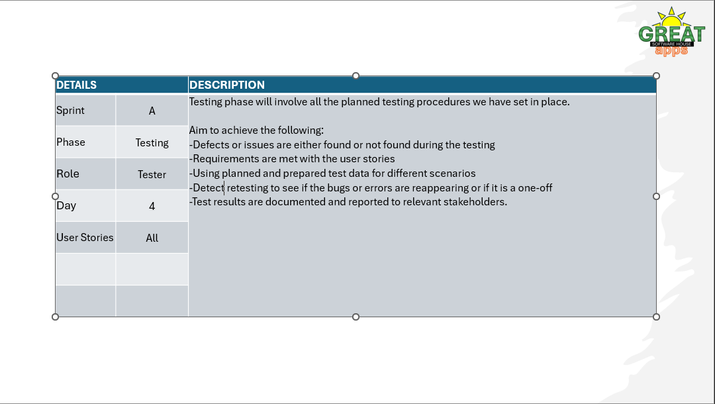

Slide 39
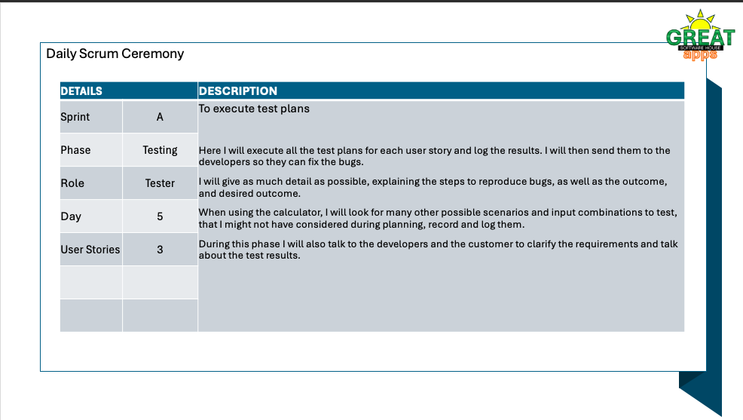

Slide 40
Day 6 | Scrum 5 Review

Slide 41
Daily Scrum Ceremony
DETAILS |  | DESCRIPTION
Sprint | A | Once the code has been brought ready to deploy, we: Seek feedback from the client via a demo I gather the feedback and present it to the team In a scrum we discuss how to proceed, and I present the new deadlines for the changes The team goes off to implement changes I update the client and other teams.
Phase | Design
Role | Project Manager/Scrum master
Day | 6
User Stories | All

Slide 42


Slide 43
Daily Scrum Ceremony
DETAILS |  | DESCRIPTION
Sprint | A | Review what can be done differently.
Phase | Review
Role | UX Designer
Day | 6
User Stories | All

Slide 44
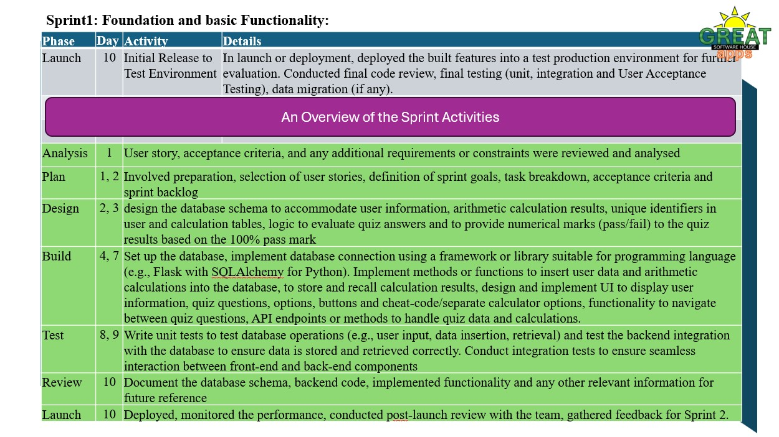

Slide 45
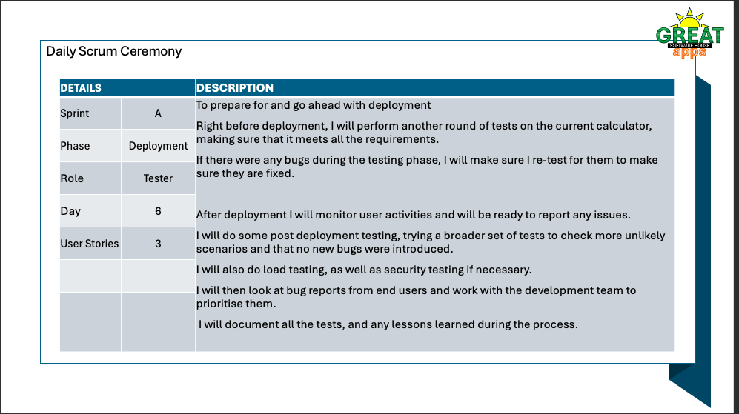

Slide 46
Day 7 | Scrum 5 Launch

